Slide 1

Problem Statement
Exercise 5.1 (Resolution predicate):
Check whether the following formulas are theorems or not using predicate resolution.

Slide 2
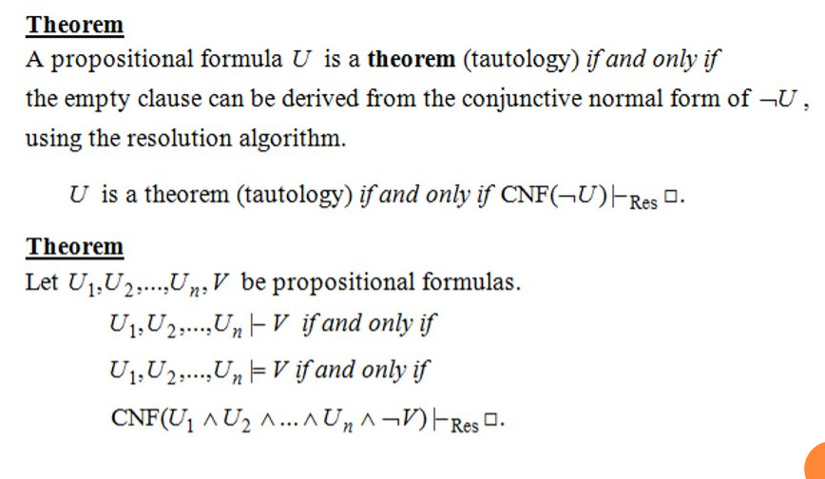
Theoretical results

Slide 3
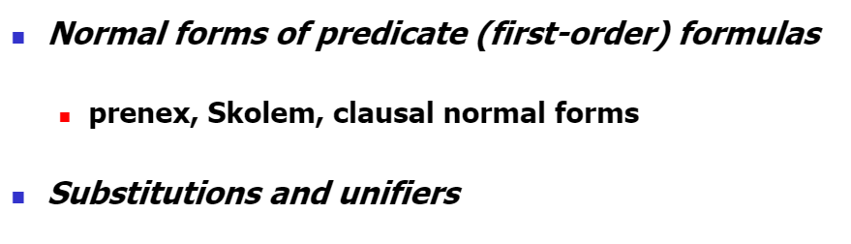
Resolution In Predicate Logic:

Slide 4
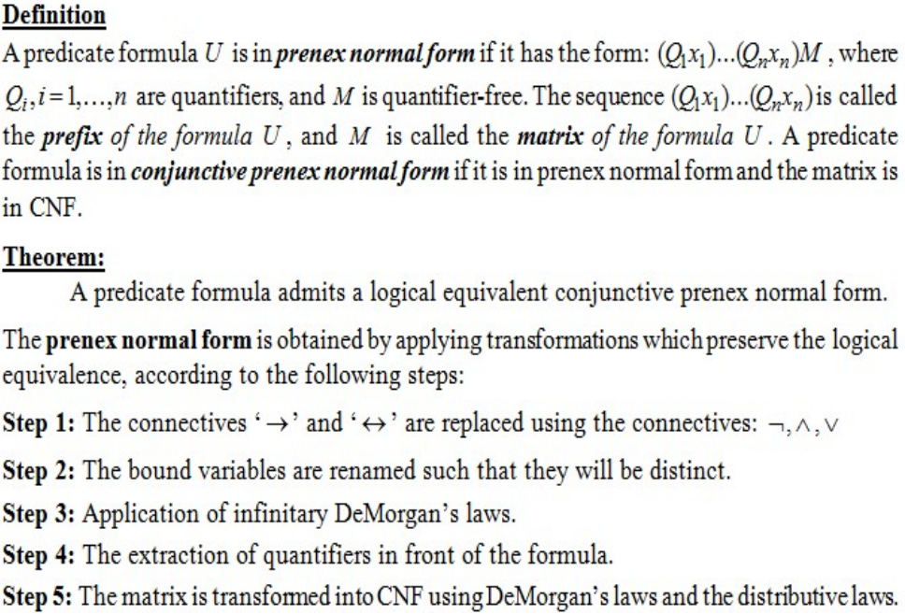
Prenex normal form

Slide 5
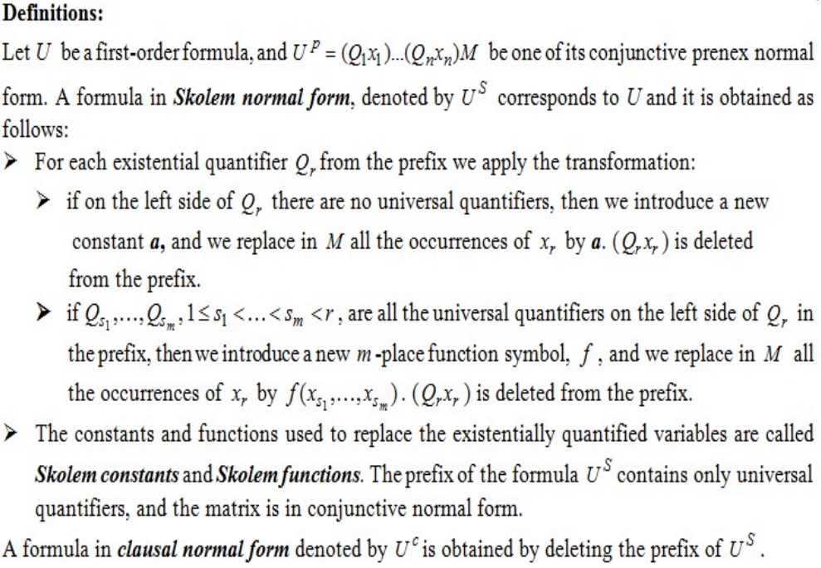
Skolem and clausal normal forms

Slide 6
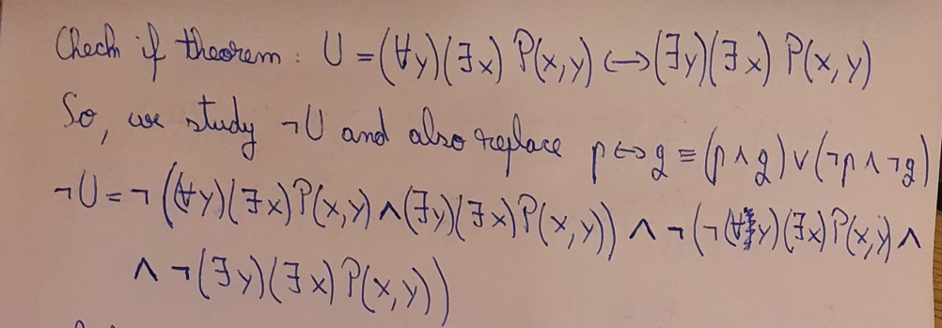
Solution + Remarks

Slide 7
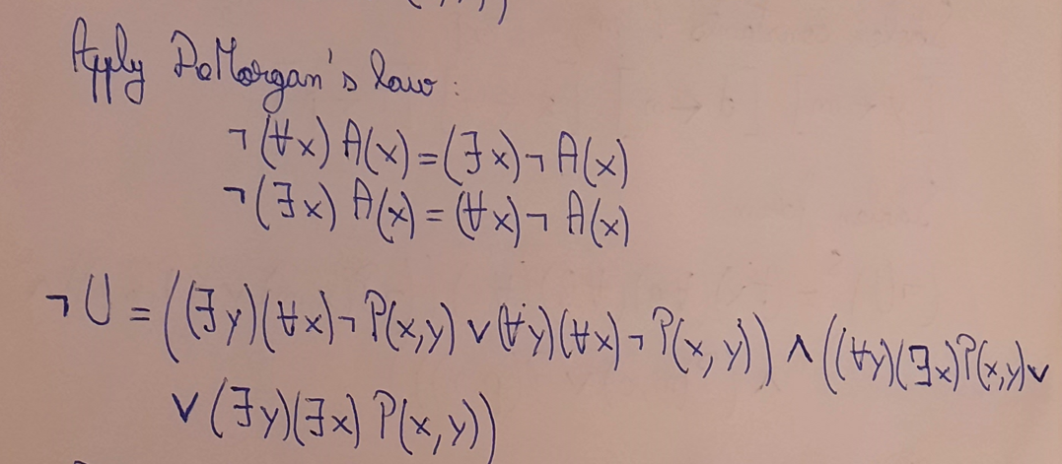

Slide 8
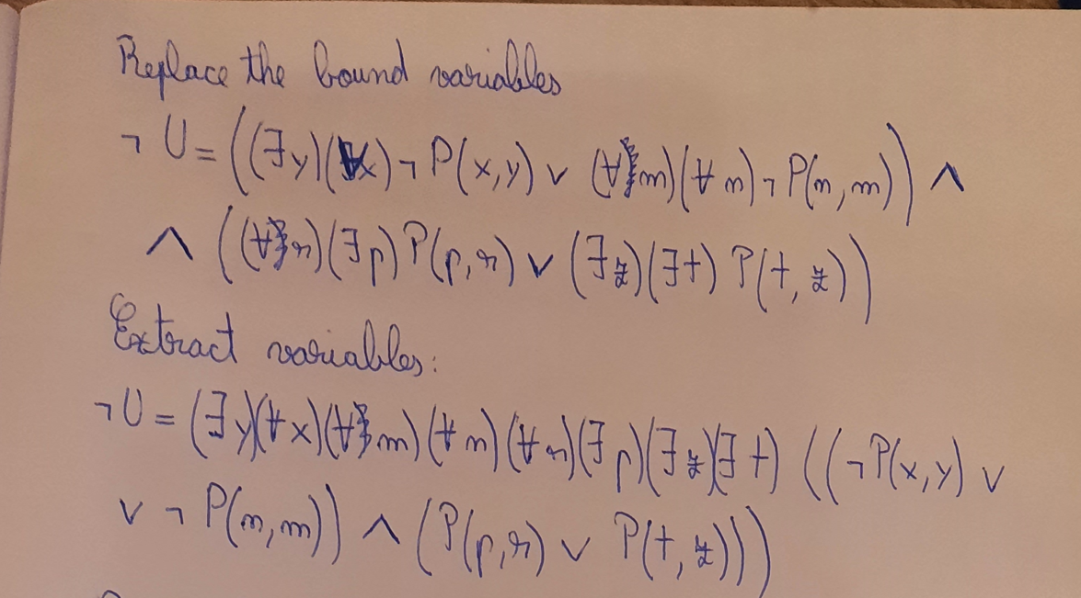

Slide 9
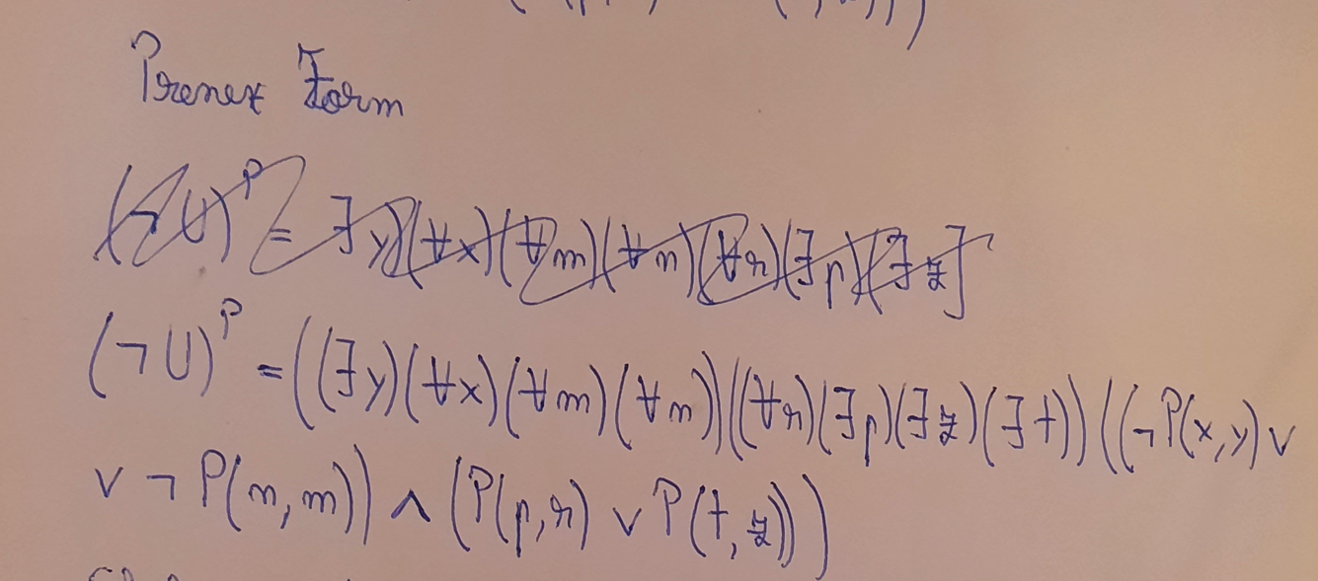

Slide 10
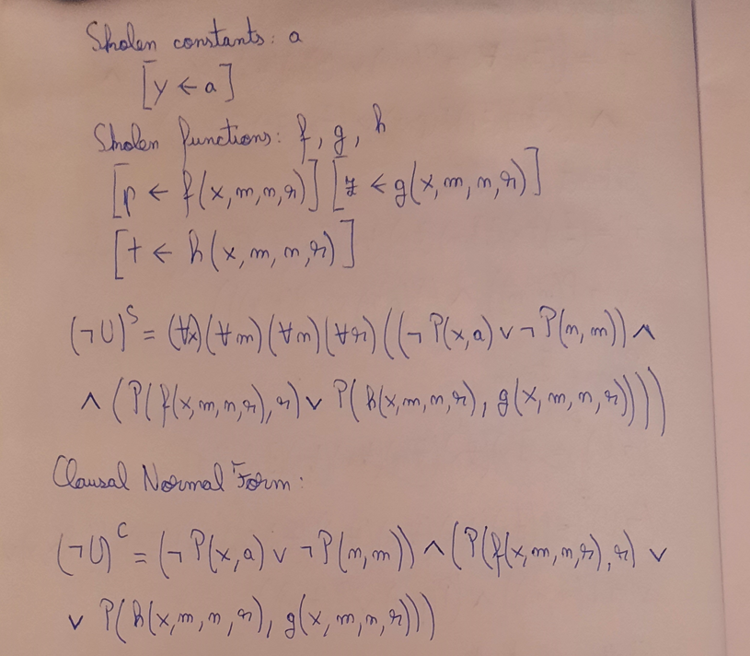

Slide 11
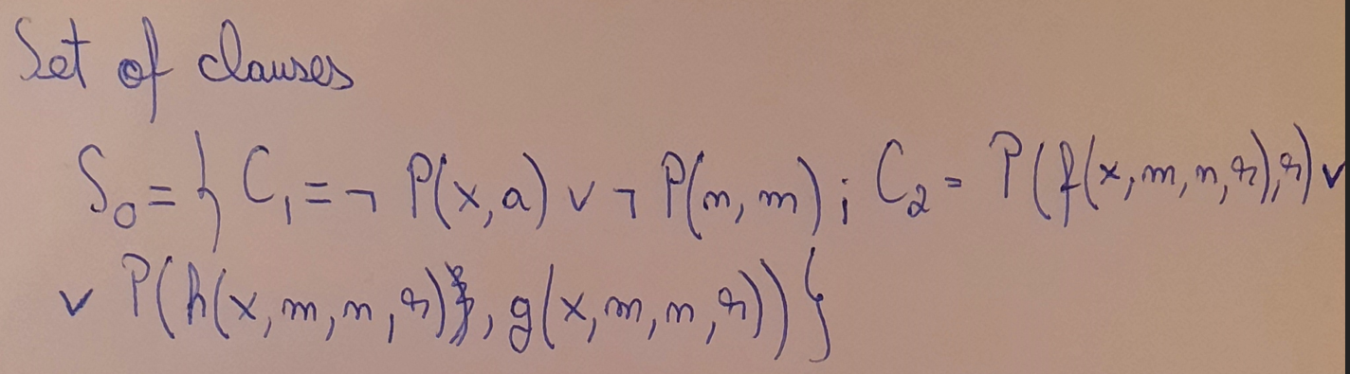

Slide 12
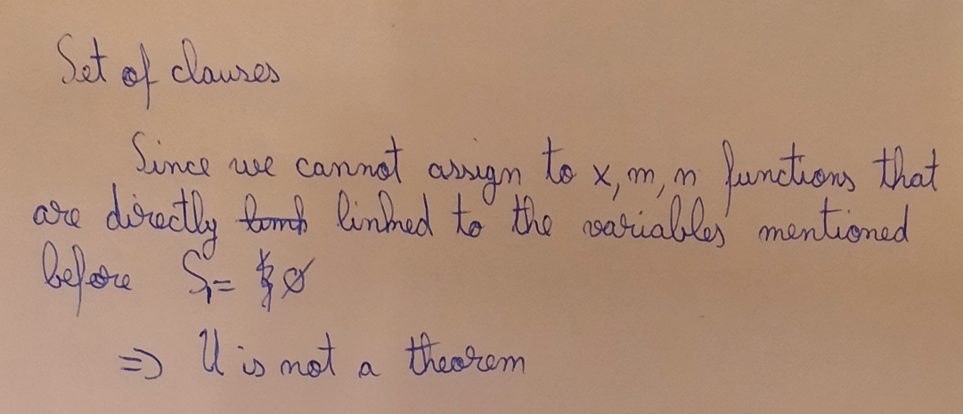

Slide 13
Badu Catalin-Ioachim
Group 911

